Slide 1
SmartShop System
A supershop management system by FOOL’S CLUB

Slide 2

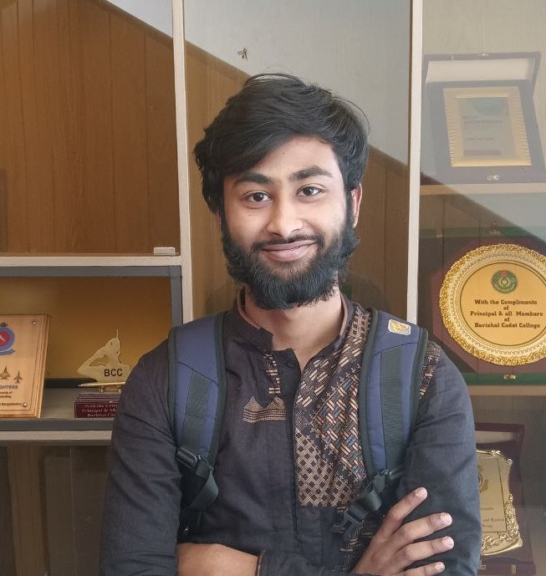

FOOL’S CLUB
01
02
03
HASIB
ALTAF
AHSAN BULBUL
MD. SAIDUR
RAHMAN
ID: 210041102
ID: 210041162
ID: 210041132

Slide 3
Project Contains
01
02
03
Keeping track of products
Customer Records
Discount on customer’s buying record
04
05
06
Automatic money receipt generation
Watching over Sales Representative’s performance
Admin ID and customer ID

Slide 4
WORK DISTRIBUTION
MD. SAIDUR RAHMAN
HASIB ALTAF
AHSAN BULBUL
Selling Product,
Checkout Menu, Receipt generation, Amount management.
Admin and Customer account management, Password handling, Styling(color).
Adding , removing and updating product. Display product.

Slide 5
Problem we have faced!!!
Cross platform functionalities
remove(), rename() function were not working as expected.
Handling invalid input.

Slide 6
THANKS
Do you have any questions?

